Slide 1
Designs and Analysis of Algorithms
Han Huang and Xiaowei Yang
South China University of Technology

Slide 2

Chapter 7
Space and Time Tradeoffs
Copyright © 2007 Pearson Addison-Wesley. All rights reserved.

Slide 3
Space and time tradeoffs in algorithm design are a well-known issue for both theoreticians and practitioners of computing.

Slide 4
Space-for-time tradeoffs
Two varieties of space-for-time algorithms:
input enhancement — preprocess the input (or its part) to store some information to be used later in solving the problem
  counting sorts
  string searching algorithms
prestructuring — preprocess the input to make accessing its elements easier
  hashing
  indexing schemes (e.g., B-trees)

Slide 5
7.1 Sorting by Counting

Slide 6
Sorting by Counting
We discuss its application to the sorting problem.
One rather obvious idea is to count, for each element of a list to be sorted, the total number of elements smaller than this element and record the results in a table.
Thus, comparison counting sort algorithm be able to sort the list by simply copying its elements to their appropriate positions in a new, sorted list.

Slide 7
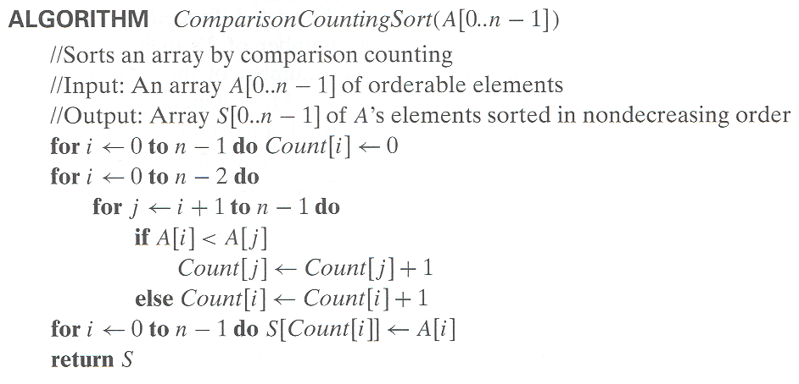

Slide 8
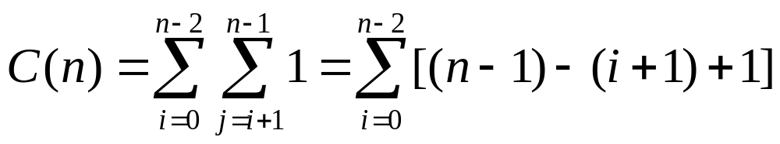
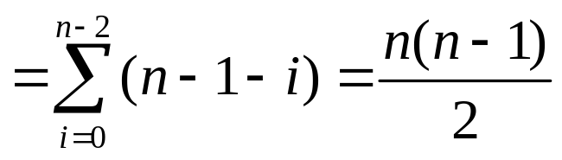
Array A[0,…5]
Initially
After pass i = 0
i = 1
i = 2
i = 3
i = 4
Final state
Array S[0…5]
62 | 31 | 84 | 96 | 19 | 47
0 | 0 | 0 | 0 | 0 | 0
3 | 0 | 1 | 1 | 0 | 0
 | 1 | 2 | 2 | 0 | 1
 |  | 4 | 3 | 0 | 1
 |  |  | 5 | 0 | 1
 |  |  |  | 0 | 2
3 | 1 | 4 | 5 | 0 | 2
19 | 31 | 47 | 62 | 84 | 96

Slide 9
The counting idea does work productively in a situation in which elements to be sorted belong to a known small set of values.
Assume, for example, that we have to sort a list whose value can be either 1 or 2.
Rather than applying a general sorting algorithm, we should be able to take advantage of this additional information about values to be sorted.

Slide 10
Example consider sorting the array
whose values are known to come from the set {11,12,13} and should not be overwritten in the process of sorting.
The frequency and distribution arrays are as follows:
13 | 11 | 12 | 13 | 12 | 12
Array values | 11 | 12 | 13
Frequencies | 1 | 3 | 2
Distribution values | 1 | 4 | 6

Slide 11
Note that the distribution values indicate the proper positions for the last occurrences of their elements in the final sorted array.
If we index array positions from 0 to n-1, the distribution values must be reduced by 1 to get corresponding element positions.
It is more convenient to process the input array right to left.

Slide 12
Example
The last element is 12, and, since its distribution value is 4, we place this 12 in position 4-1 = 3 of the array S that hold the sorted list. Then we decrease the 12’s distribution value by 1 and proceed to the next element in the given array.
A[5]= 12
A[4]= 12
A[3]= 13
A[2]= 12
A[1]= 11
A[0]= 13
1 | 4 | 6
1 | 3 | 6
1 | 2 | 6
1 | 2 | 5
1 | 1 | 5
0 | 1 | 5
 |  |  | 12
 |  | 12
 |  |  |  |  | 13
 | 12
11
 |  |  |  | 13

Slide 13
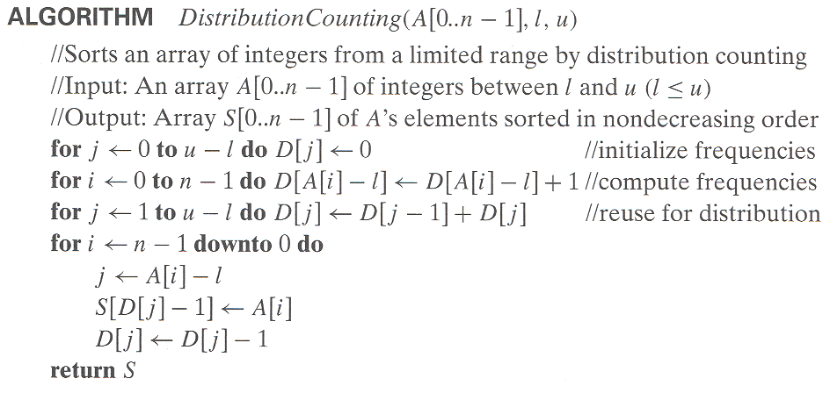

Slide 14
Assuming that the range of array values is fixed, this is obviously a linear algorithm because it makes just two consecutive passes through its input array A.
This is a better time-efficiency class than that of the most efficient sorting algorithms – mergesort(O(nlogn), quicksort, and heapsort – we have encountered.

Slide 15
7.2 Input Enhancement in String Matching

Slide 16
Review: String searching by brute force
pattern: a string of m characters to search for
text: a (long) string of n characters to search in
Brute force algorithm
Step 1 Align pattern at beginning of text
Step 2 Moving from left to right, compare each character of pattern to the corresponding character in text until either all characters are found to match (successful search) or a mismatch is detected
Step 3 While a mismatch is detected and the text is not yet exhausted, realign pattern one position to the right and repeat Step 2

Slide 17
String searching by preprocessing
Several string searching algorithms are based on the input enhancement idea of preprocessing the pattern
Knuth-Morris-Pratt (KMP) algorithm preprocesses pattern left to right to get useful information for later searching
Boyer -Moore algorithm preprocesses pattern right to left and store information into two tables
Horspool’s algorithm simplifies the Boyer-Moore algorithm by using just one table

Slide 18
Horspool’s Algorithm
A simplified version of Boyer-Moore algorithm:
  preprocesses pattern to generate a shift table that determines how much to shift the pattern when a mismatch occurs
  always makes a shift based on the text’s character c aligned with the last character in the pattern according to the shift table’s entry for c

Slide 19
How far to shift?
Look at first (rightmost) character in text that was compared:
The character is not in the pattern
.....c...................... (c not in pattern)
BAOBAB
The character is in the pattern (but not the rightmost)
.....O...................... (O occurs once in pattern)
BAOBAB
.....A...................... (A occurs twice in pattern)
BAOBAB
The rightmost characters do match
.....B......................
BAOBAB

Slide 20
Shift table
Shift sizes can be precomputed by the distance from the rightmost c among its first m-1 characters of the pattern to its right end
t(c) = pattern’s length m, otherwise
by scanning pattern before search begins and stored in a table called shift table
Shift table is indexed by text and pattern alphabet
Eg, for BAOBAB:
A B C D E F G H I J K L M N O P Q R S T U V W X Y Z
1 2 6 6 6 6 6 6 6 6 6 6 6 6 3 6 6 6 6 6 6 6 6 6 6 6

Slide 21
Example of Horspool’s alg. application
BARD LOVED BANANAS
BAOBAB
BAOBAB
BAOBAB
BAOBAB (unsuccessful search)
A B C D E F G H I J K L M N O P Q R S T U V W X Y Z
_
1 2 6 6 6 6 6 6 6 6 6 6 6 6 3 6 6 6 6 6 6 6 6 6 6 6
6

Slide 22
Horspool’s algorithm
Step 1. For a given pattern of length m and the alphabet used in both the pattern and text, construct the shift table as describe above.
Step 2. Align the pattern against the beginning of the text.
Step 3. Repeat the following until either a matching substring is found or the pattern reaches beyond the last character or the text.

Slide 23
Starting with the last character in the pattern, compare the corresponding characters in the pattern and text until either all m characters are matched (then stop) or a mismatching pair is encountered.
In the latter case, retrieve the entry t(c) from the c’s column of the shift table where c is the text’ character currently aligned against the last character of the pattern, and shift the pattern by t(c) characters to the right along the text.

Slide 24
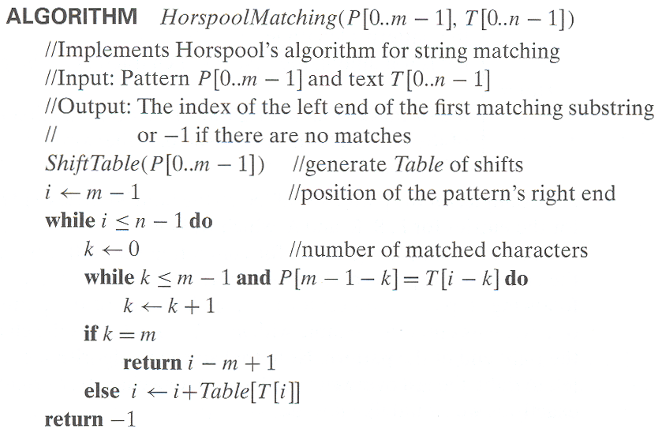

Slide 25
Boyer-Moore algorithm
Based on same two ideas:
  comparing pattern characters to text from right to left
  precomputing shift sizes in two tables
    bad-symbol table indicates how much to shift based on text’s character causing a mismatch
    good-suffix table indicates how much to shift based on matched part (suffix) of the pattern

Slide 26
Bad-symbol shift in Boyer-Moore algorithm
If the rightmost character of the pattern doesn’t match, BM algorithm acts as Horspool’s
If the rightmost character of the pattern does match, BM compares preceding characters right to left until either all pattern’s characters match or a mismatch on text’s character c is encountered after k > 0 matches
text
pattern
bad-symbol shift d₁ = max{t₁(c ) - k, 1}
c
k matches

Slide 27
Good-suffix shift in Boyer-Moore algorithm
Good-suffix shift d₂ is applied after 0 < k < m last characters were matched
d₂(k) = the distance between matched suffix of size k and its rightmost occurrence in the pattern that is not preceded by the same character as the suffix
If there is no such occurrence, match the longest part of the k-character suffix with corresponding prefix;
if there are no such suffix-prefix matches, d₂ (k) = m
Example: ABCBAB d₂(1) = 2, d₂(2) = 4, d₂(3) = 4, d₂(4) =4

Slide 28
Boyer-Moore Algorithm
After matching successfully 0 < k < m characters, the algorithm shifts the pattern right by d = max {d₁, d₂}
where d₁ = max{t₁(c) - k, 1} is bad-symbol shift
d₂(k) is good-suffix shift
Example: Find pattern AT_THAT in
WHICH_FINALLY_HALTS. _ _ AT_THAT

Slide 29
Boyer-Moore Algorithm (cont.)
Step 1 Fill in the bad-symbol shift table
Step 2 Fill in the good-suffix shift table
Step 3 Align the pattern against the beginning of the text
Step 4 Repeat until a matching substring is found or text ends:
Compare the corresponding characters right to left.

Slide 30
If no characters match, retrieve entry t₁(c) from the bad-symbol table for the text’s character c causing the mismatch and shift the pattern to the right by t₁(c).
If 0 < k < m characters are matched, retrieve entry t₁(c) from the bad-symbol table for the text’s character c causing the mismatch and entry d₂(k) from the good-suffix table and shift the pattern to the right by d = max {d₁, d₂}
where d₁ = max{t₁(c) - k, 1}.

Slide 31
Example of Boyer-Moore alg. application
B E S S _ K N E W _ A B O U T _ B A O B A B S
B A O B A B
d₁ = t₁(K) = 6 B A O B A B
d₁ = t₁(_)-2 = 4
d₂(2) = 5
B A O B A B
d₁ = t₁(_)-1 = 5
d₂(1) = 2
B A O B A B (success)
A B C D E F G H I J K L M N O P Q R S T U V W X Y Z
_
1 2 6 6 6 6 6 6 6 6 6 6 6 6 3 6 6 6 6 6 6 6 6 6 6 6
6
k | pattern | d₂
1 | BAOBAB | 2
2 | BAOBAB | 5
3 | BAOBAB | 5
4 | BAOBAB | 5
5 | BAOBAB | 5

Slide 32
7.3 Hashing

Slide 33
Hashing is based on the idea of distributing keys among a one-dimensional array H[0..m-1] called a hash table.
The distribution is done by computing, for each of the keys, the value of some predefined function h called the hash function.
This function assigns an integers between 0 and m-1, called the hash address, to a key.

Slide 34
If keys are nonnegative integers, a hash function can be of the form h(K) = K mod m.
If keys are letters of some alphabets, we can first assign a letter its position in the alphabet and then apply the same kind of a function of a function used for integer.
Finally, if K is a character string c0c1…cs-1, we can use, as a very unsophisticated option.

Slide 35
Hashing
A very efficient method for implementing a dictionary, i.e., a set with the operations:
    find
    insert
    delete
Based on representation-change and space-for-time tradeoff ideas
Important applications:
    symbol tables
    databases (extendible hashing)

Slide 36
Hash tables and hash functions
The idea of hashing is to map keys of a given file of size n into a table of size m, called the hash table, by using a predefined function, called the hash function,
h: K → location (cell) in the hash table

Slide 37
Example: student records, key = SSN. Hash function:
h(K) = K mod m where m is some integer (typically, prime)
If m = 1000, where is record with SSN= 314159265 stored?
Generally, a hash function should:
  be easy to compute
  distribute keys about evenly throughout the hash table

Slide 38
A hash function needs to satisfy two somewhat conflicting requirements:
A hash function needs to distribute keys among the cells of the hash table as every as possible.
(Because of this requirement, the value of m is usually chosen to be prime. The requirement also makes it desirable, for most applications, to have a hash function dependent on all bits of a key, not just some of them)
A hash function has to be easy to compute.

Slide 39
Collisions
If h(K₁) = h(K₂), there is a collision
Good hash functions result in fewer collisions but some collisions should be expected (birthday paradox)
Two principal hashing schemes handle collisions differently:
  Open hashing – each cell is a header of linked list of all keys hashed to it
  Closed hashing
    one key per cell in case of collision, finds another cell by
      linear probing: use next free bucket
      double hashing: use second hash function to compute increment

Slide 40
Open hashing (Separate chaining)
Keys are stored in linked lists outside a hash table whose elements serve as the lists’ headers.
Example: A, FOOL, AND, HIS, MONEY, ARE, SOON, PARTED
h(K) = sum of K ‘s letters’ positions in the alphabet MOD 13
Key | A | FOOL | AND | HIS | MONEY | ARE | SOON | PARTED
h(K) | 1 | 9 | 6 | 10 | 7 | 11 | 11 | 12
0
1
2
3
4
5
6
7
8
9
10
11
12
A
AND
MONEY
FOOL
HIS
ARE
PARTED
SOON
Search for KID

Slide 41
Open hashing (cont.)
If hash function distributes keys uniformly, average length of linked list will be α = n/m. This ratio is called load factor.
Average number of probes in successful, S, and unsuccessful searches, U:
S ≈ 1+α/2, U = α
Load α is typically kept small (ideally, about 1)
Open hashing still works if n > m

Slide 42
Closed hashing (Open addressing)
Keys are stored inside a hash table.
Key | A | FOOL | AND | HIS | MONEY | ARE | SOON | PARTED
h(K) | 1 | 9 | 6 | 10 | 7 | 11 | 11 | 12
0
1
2
3
4
5
6
7
8
9
10
11
12
 | A
 | A |  |  |  |  |  |  |  | FOOL
 | A |  |  |  |  | AND |  |  | FOOL
 | A |  |  |  |  | AND |  |  | FOOL | HIS
 | A |  |  |  |  | AND | MONEY |  | FOOL | HIS
 | A |  |  |  |  | AND | MONEY |  | FOOL | HIS | ARE
 | A |  |  |  |  | AND | MONEY |  | FOOL | HIS | ARE | SOON
PARTED | A |  |  |  |  | AND | MONEY |  | FOOL | HIS | ARE | SOON

Slide 43
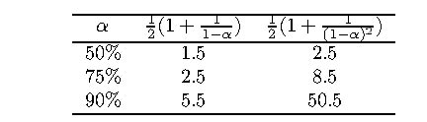
Closed hashing (cont.)
Does not work if n > m
Avoids pointers
Deletions are not straightforward
Number of probes to find/insert/delete a key depends on load factor α = n/m (hash table density) and collision resolution strategy. For linear probing: S = (½) (1+ 1/(1- α)) and U = (½) (1+ 1/(1- α)²)
As the table gets filled (α approaches 1), number of probes in linear probing increases dramatically:

Slide 44
7.4 B-Trees

Slide 45
B-Trees
The idea of using extra space to facilitate faster access to a given data set is particularly important if the data set in question contains a very large number of records that need to be stored on a disk.
A principal device in organizing such data sets in an index, which provides some information about the location of records with indicated key values.

Slide 46
For data sets of structured records, the most important index organization is the B-tree, introduced by R. Bayer and E. McGreight.
It extends the idea of the 2-3 tree by permitting more than a single key in the same node of a search tree.
In the B-tree version we consider here, all data records are stored at the leaves, in increasing order of the keys.

Slide 47
Parental node of B-tree
P0
K1
P1
…
Pi-1
Ki
Pi
Pn-2
Kn-1
Pn-1
T0
T1
Ti-1
Ti
Tn-2
Tn-1

Slide 48
Example of a B-tree of order 4
20
51
11
15
25
34
40
60
4,
7,
10
11,
14
15,
16,
19
20,
24
25,
28
34,
38
40,
43,
46
51,
55
60,
68,
80

Slide 49
The root is either a leaf or has between 2 and m children.
Each node, except for the root and the leaves, has between [m/2] and m children (and hence between [m/2]-1 and m-1 keys)
The tree is (perfectly) balanced; i.e., all its leaves are at the same level.

Slide 50
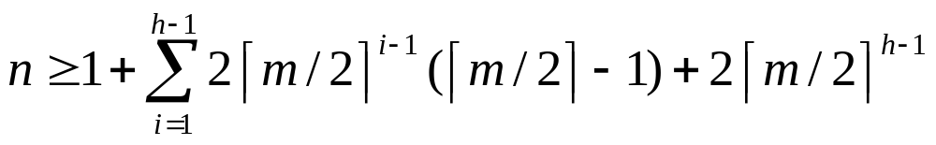
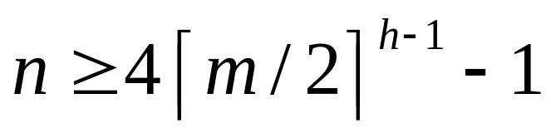
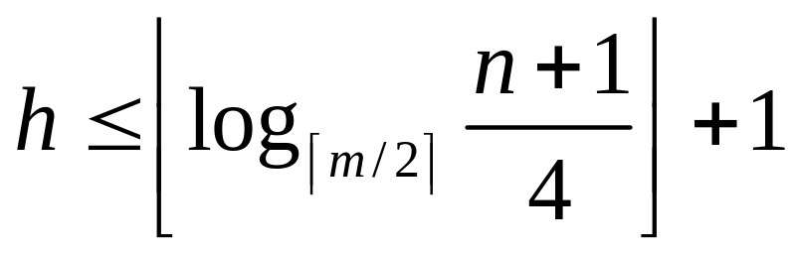
For any B-tree of order m with n height h>0
Order m | 50 | 100 | 250
h’s upper bound | 6 | 5 | 4

Slide 51
B-tree obtained after inserting 65 into B-tree
20
51
11
15
25
34
40
60
68
4,
7,
10
11,
14
15,
16,
19
20,
24
25,
28
34,
38
40,
43,
46
51,
55
60,
65
68,
80

Slide 52
End of the Section 7
Click to edit company slogan .

